Slide 1
Applications of Information & Communication Technology
Mr. Ali Haider
Institute Of Management Sciences

Slide 2
How Data is stored from HTML Form
Practical Example
Tools used: Xampp, Apache Server, MySQL, Google Chrome.
Languages Used: HTML, CSS, PHP, mySQL

Slide 3
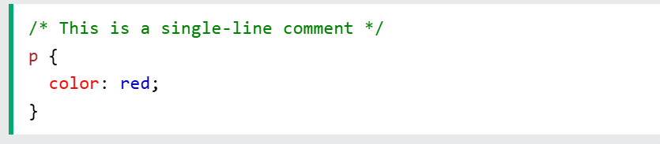
CSS Comment
Comments are used to explain the code, and may help when you edit the source code at a later date.
Comments are ignored by browsers.
A CSS comment is placed inside the <style> element, and starts with /* and ends with */

Slide 4
CSS Colors
Color Name
RGB: rgb(255,0,255)
HEX: Hexadecimal , #fa5491
HSL: Hue, Saturation , Light. Hsl(300, 5%, 10%)
HSLA: A is for Transparent. Hsla(300,5%, 10%, 0.5)
RGBA: rgba(155,50, 100, 0.5)

Slide 5
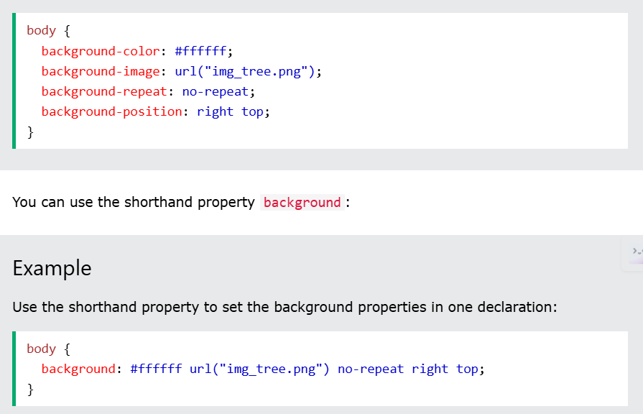
CSS Property Shorthand
To shorten the code, it is also possible to specify all the background or any types’ properties in one single property. This is called a shorthand property.

Slide 6
CSS Box Model
https://www.w3schools.com/css/css_boxmodel.asp

Slide 7
CSS Properties
outline-style
outline-color
outline-width
outline-offset
outline
list-style-type
top
bottom
right
left
float
min-width
min-height
max-width
max-height
border-radius
border-color
border-style
border-width
overflow
overflow-x
overflow-y

Slide 8
Thank You.
The End

